Slide 1

Pittsburgh Police Arrest Data
Niloofar Zarifi
DATA SCIENCE AND APPLICATION
April 08, 2019

Slide 2
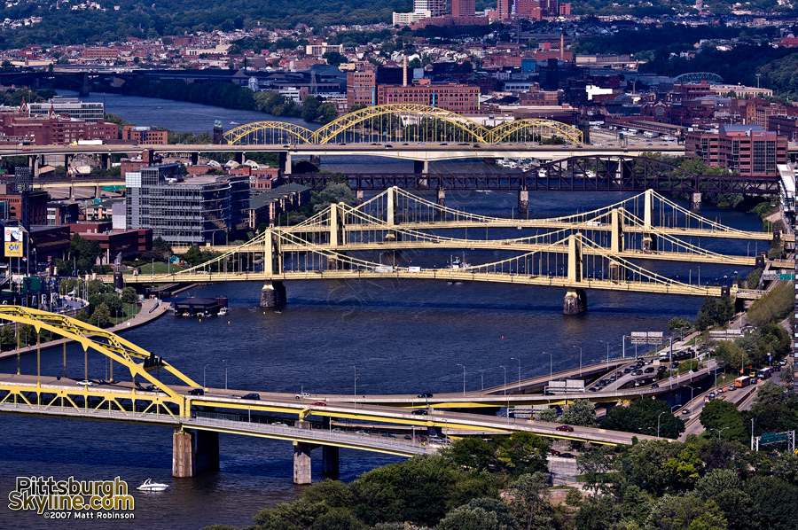
Pittsburgh Police Arrest Data
Available at https://www.data.gov/
Contains information on people taken into custody by City of Pittsburgh police officers
All data is reported with the exception of sex crimes.
Indexes: 'AGE', 'GENDER', 'RACE', 'ARRESTTIME', 'ARRESTLOCATION', 'OFFENSES', 'INCIDENTLOCATION', 'INCIDENTNEIGHBORHOOD', 'INCIDENTZONE', 'INCIDENTTRACT', 'COUNCIL_DISTRICT', 'PUBLIC_WORKS_DIVISION'

Slide 3

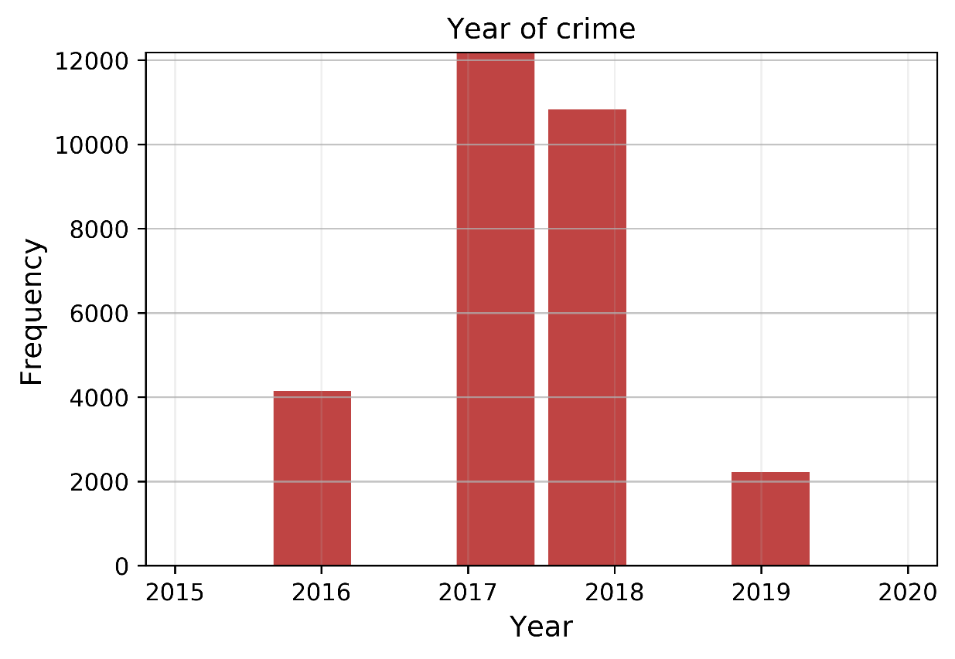
ARRESTTIME
Descriptions:
ARRESTTIME format: 2016-08-24T12:20:00
Few data points belong to years between 2005 to 2015
Preprocessing:
Create new columns of year, month, day, hours
Keep the data from 2016 to 2019
Q1: Which year has the most arrestment?
Year Count
2017 12175
2018 10832
2016 4144
2019 2218

Slide 4
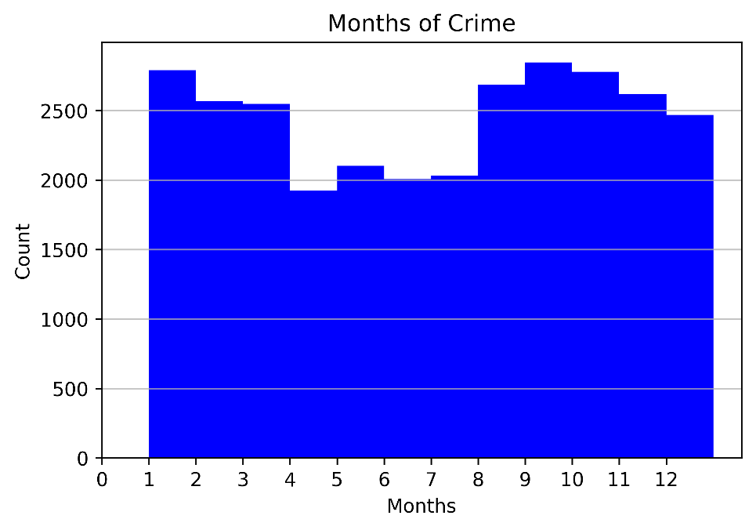
ARRESTTIME
Q2: Which months police has the most arrestment?
Sol: create dictionary to change number to month abbreviation
{'Aug': 2685, 'Sep': 2847, 'Jul': 2032, 'Jun': 2006,
'Feb': 2569, 'Apr': 1922, 'Oct': 2779, 'Nov': 2620,
'Dec': 2469, 'Mar': 2548, 'Jan': 2790, 'May': 2102}
Q3:Which season is busy ?
Sol: define a function to convert months to four seasons
Winter 7907
Fall 7868
Summer 7564
Spring 6030

Slide 5
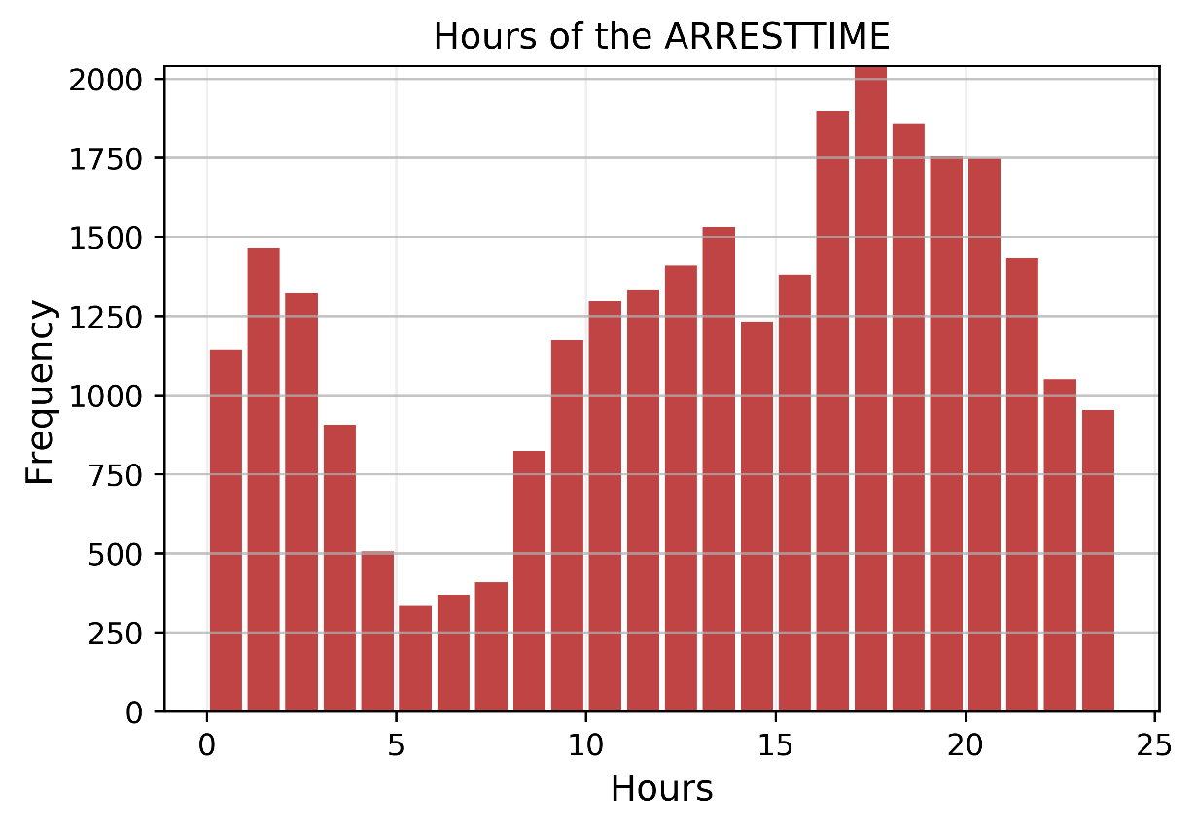
ARRESTTIME
Q4: What hours police does more arrestment?
Apparently the rush hour for Pittsburgh police
at the street starts after 5 pm!
The most arrestment records from
6 to 9 pm
Q5:Does police rest on weekends?
counts %
Wednesday 4614 15.697615
Tuesday 4607 15.673800
Thursday 4578 15.575137
Friday 4549 15.476474
Monday 4052 13.785595
Saturday 3765 12.809172
Sunday 3228 10.982207

Slide 6
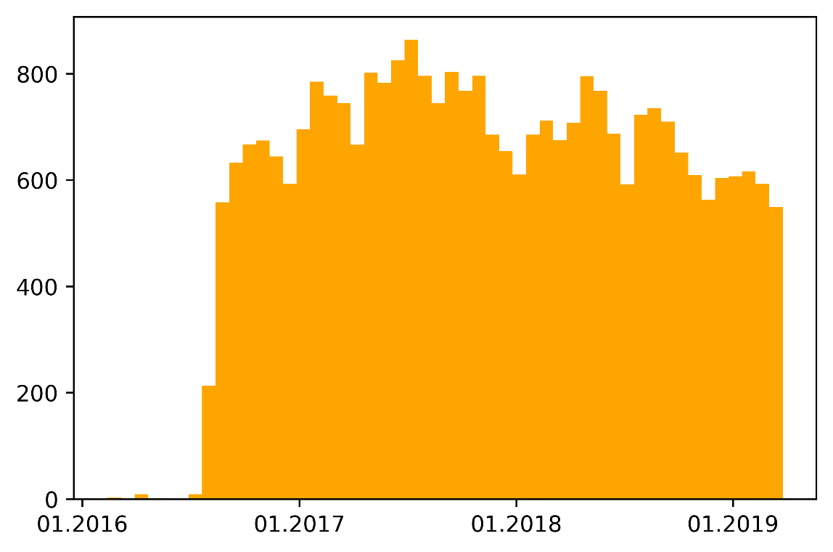
ARRESTTIME
Q6: The records of last 4 years indicate that winter season in general
Is the busiest month for crime. Is it always true or the maximum
crime record differs for each year?
The data set is incomplete for 2016
Fall 2017 has the max record
Spring 2018 has the max record
The challenge : I created the string of
2016_01 to 2019_3, then count the
year_month columns. The problem was the dataset was
not fully in order for 2016.
To avoid sorting the ARRESTTIME I used
Matplotlib format to deal with date

Slide 7
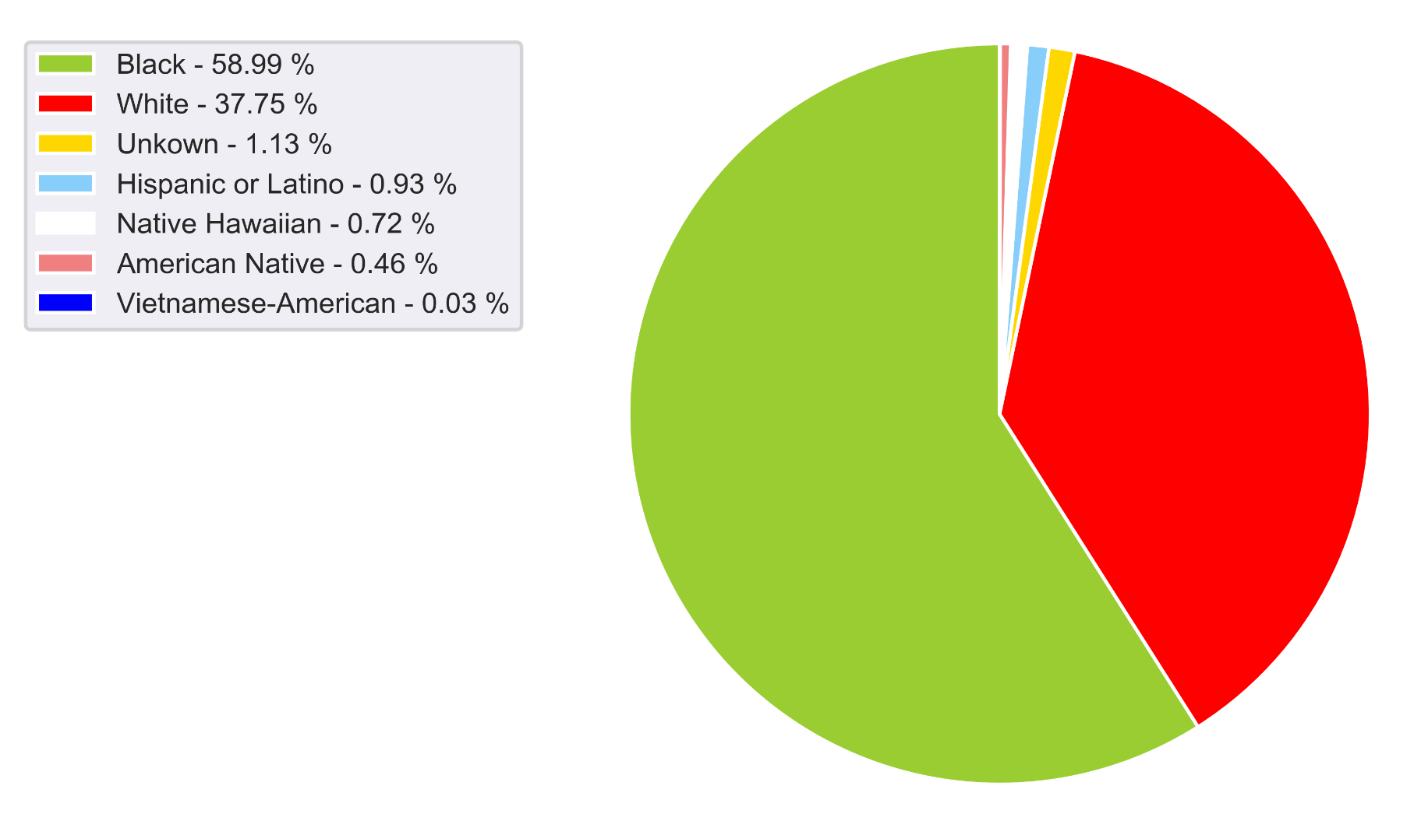
RACE
Q7: Show the statistic of the RACE for crime?
The challenge: overlapping of percentage with variables inside the pie chart
counts %
Black 17324 58.987368
White 11087 37.750690
Unknown 332 1.130444
Hispanic or Latino 274 0.932957
Native Hawaiian 210 0.715040
American Native 134 0.456263
Vietnamese-American 8 0.027240

Slide 8
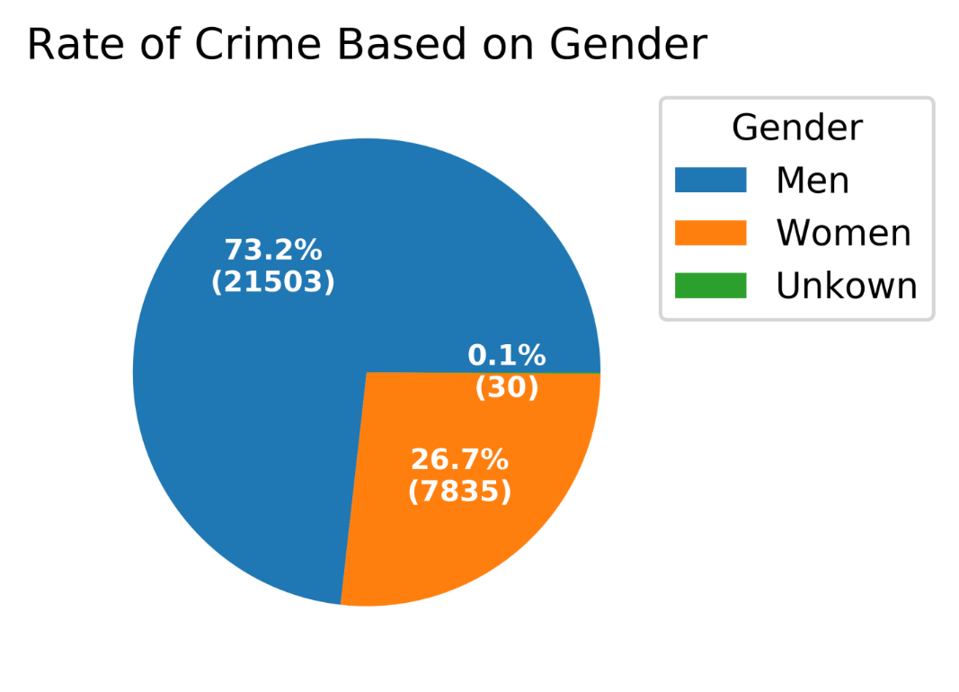
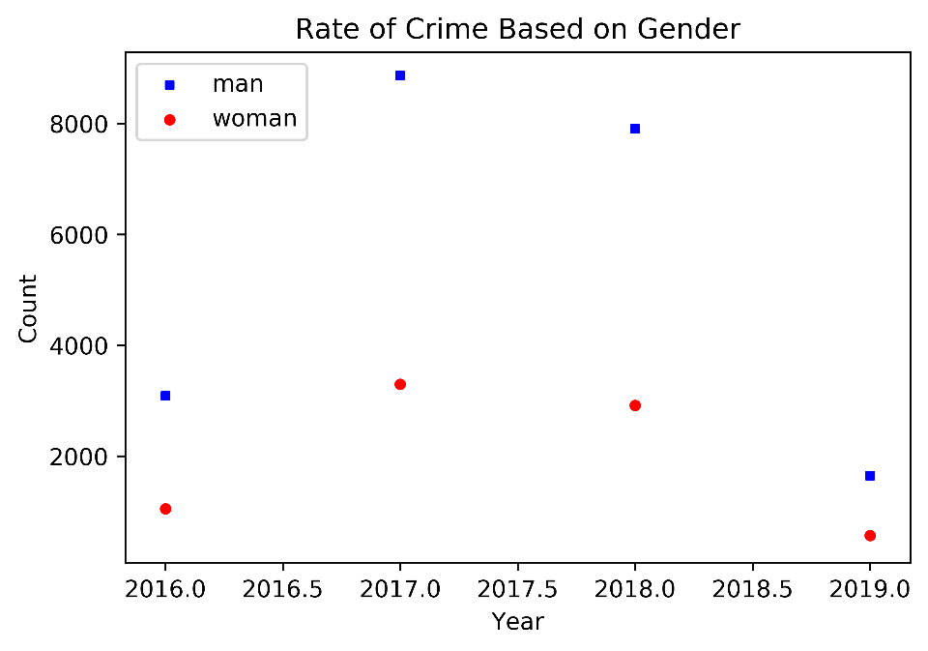
GENDER
Q8: Show the rate of crime based on gender:
Q9: does the Crime rate increase or decrease from 2016 to 2019?
We could do the same comparison for race and gender and year

Slide 9
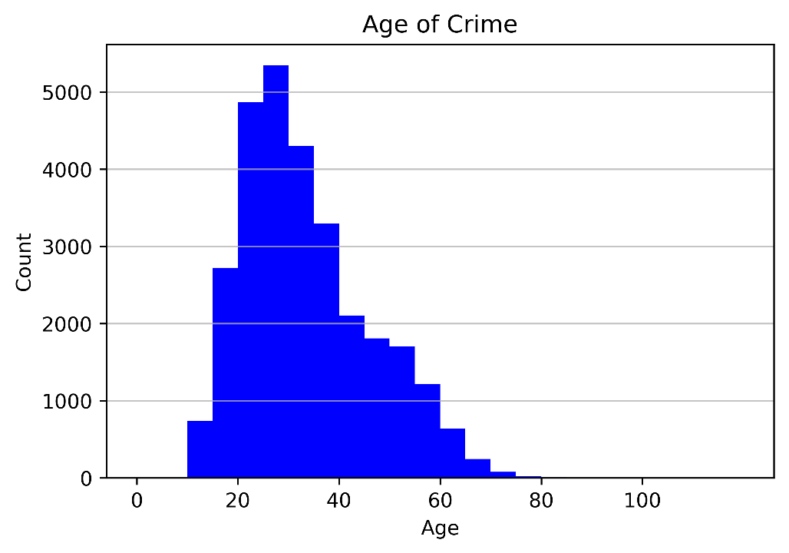
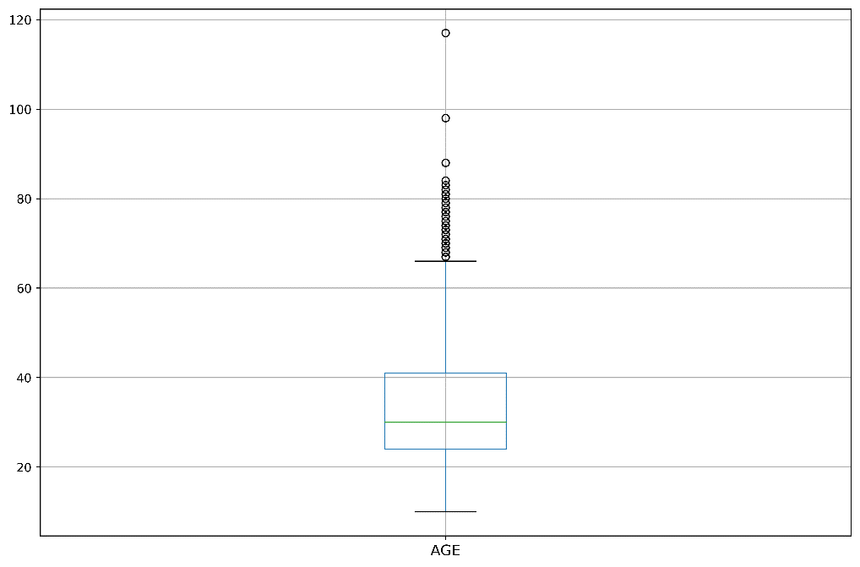
AGE
Preprocessing:
There are missing, 0 and 999 values for age
Q10: investigate the age of crime
count 29100.000000 total data was
mean 33.044124
std 12.674671
min 10.000000 Aggravated Assault
25% 24.000000
50% 30.000000
75% 41.000000
max 117.000000 Disorderly Conduct. / 3926.C1 THEFT OF SERVICES

Slide 10
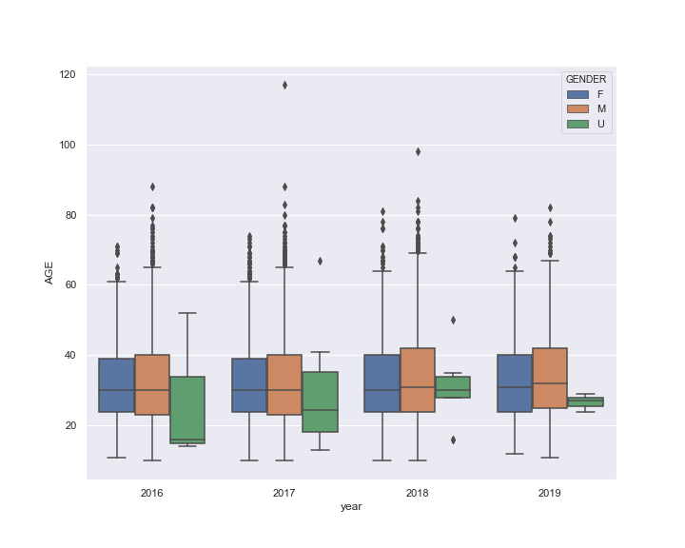
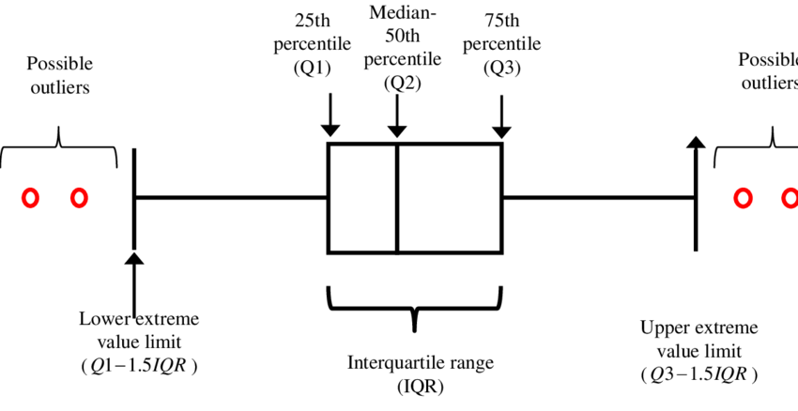
AGE
Q11: age vs year vs gender?
Median values is almost 30 for all years
Outliers are +60
The python boxplot default is 1.5IQR

Slide 11
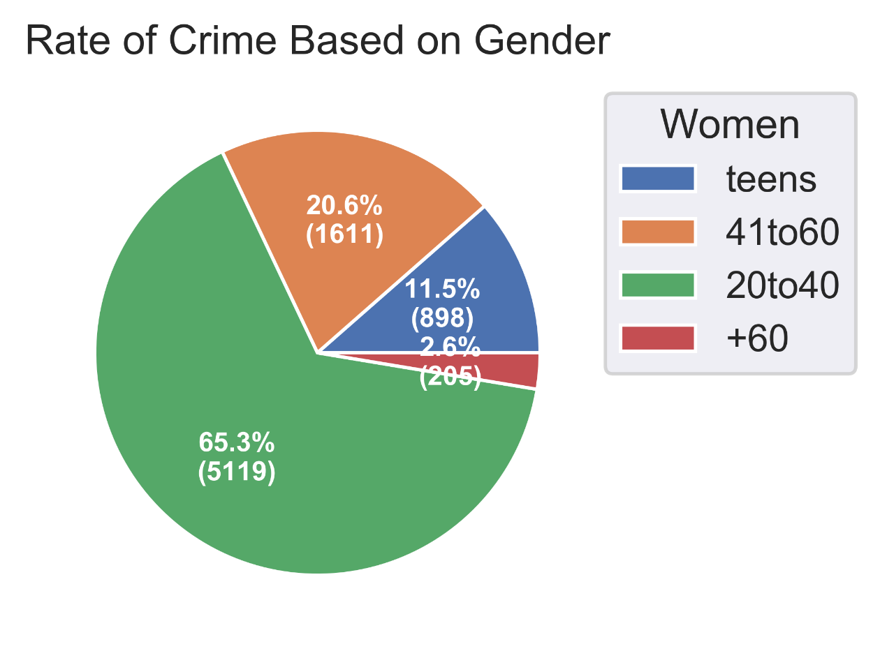
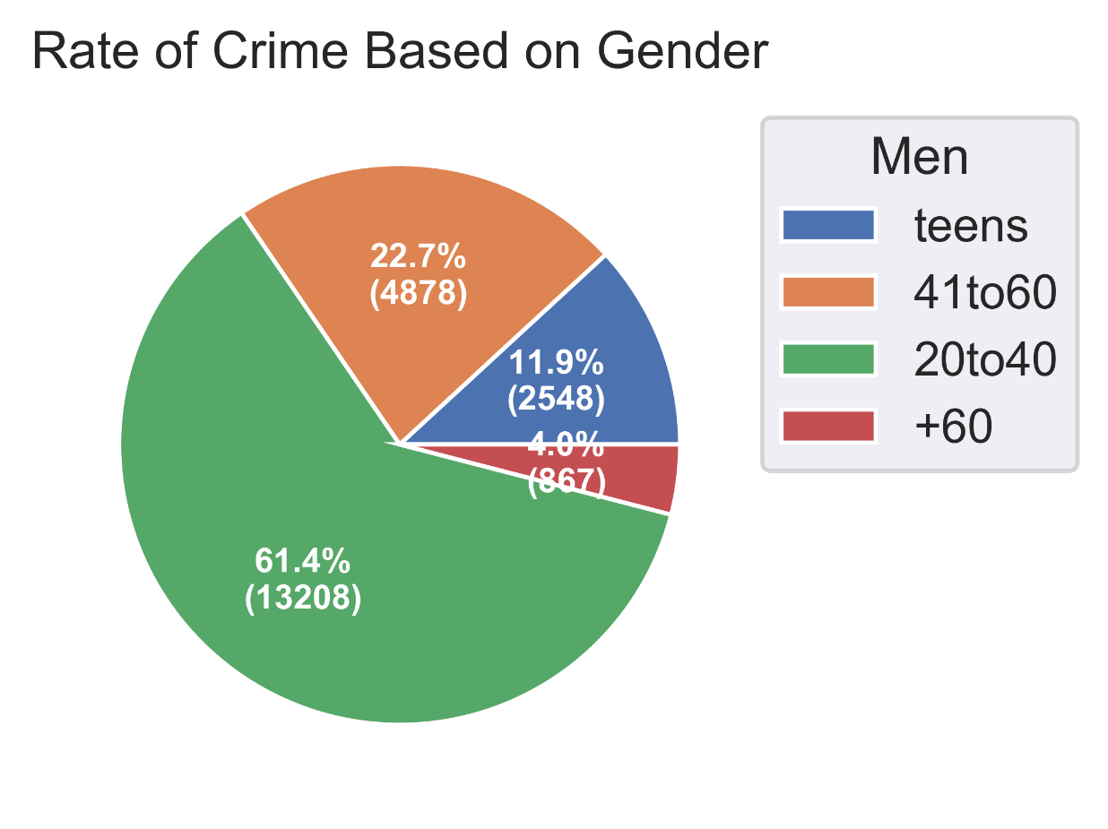
AGE
Q12: Create age group

Slide 12
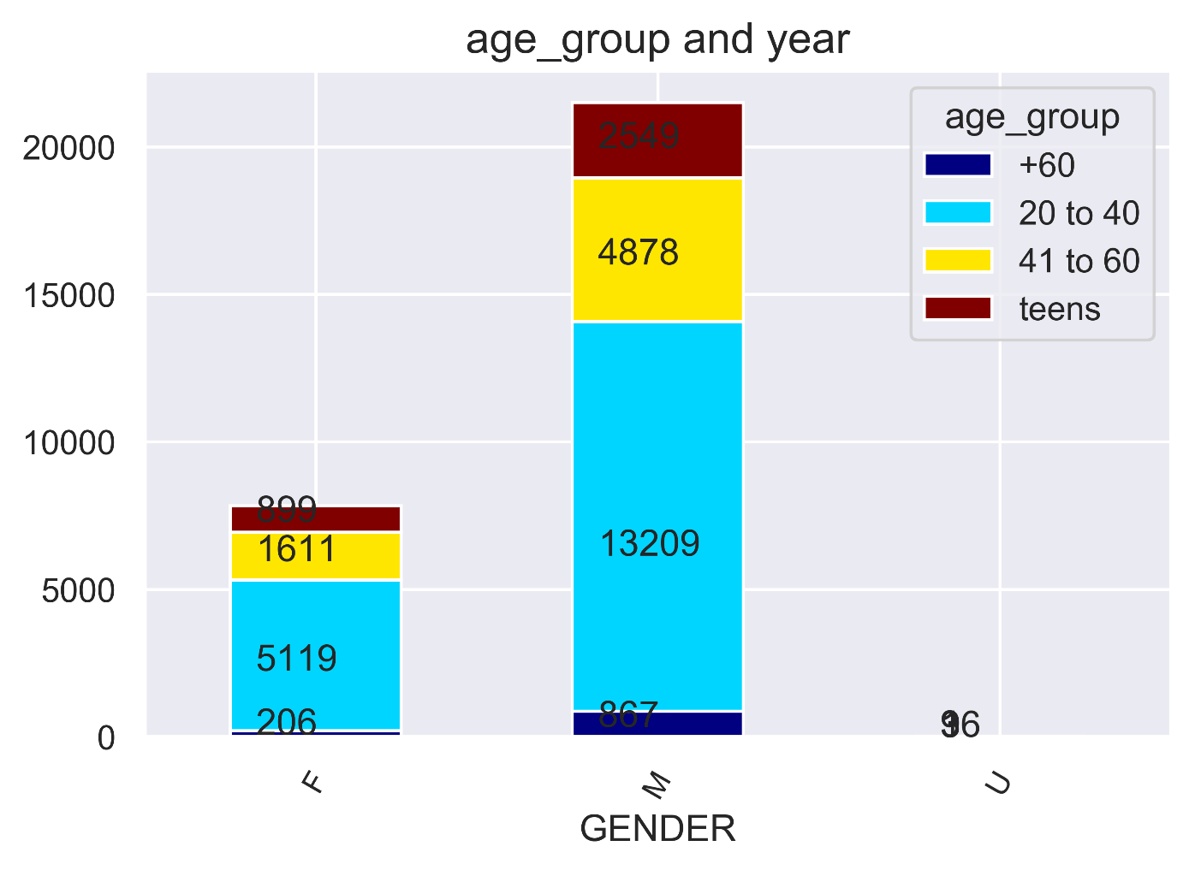
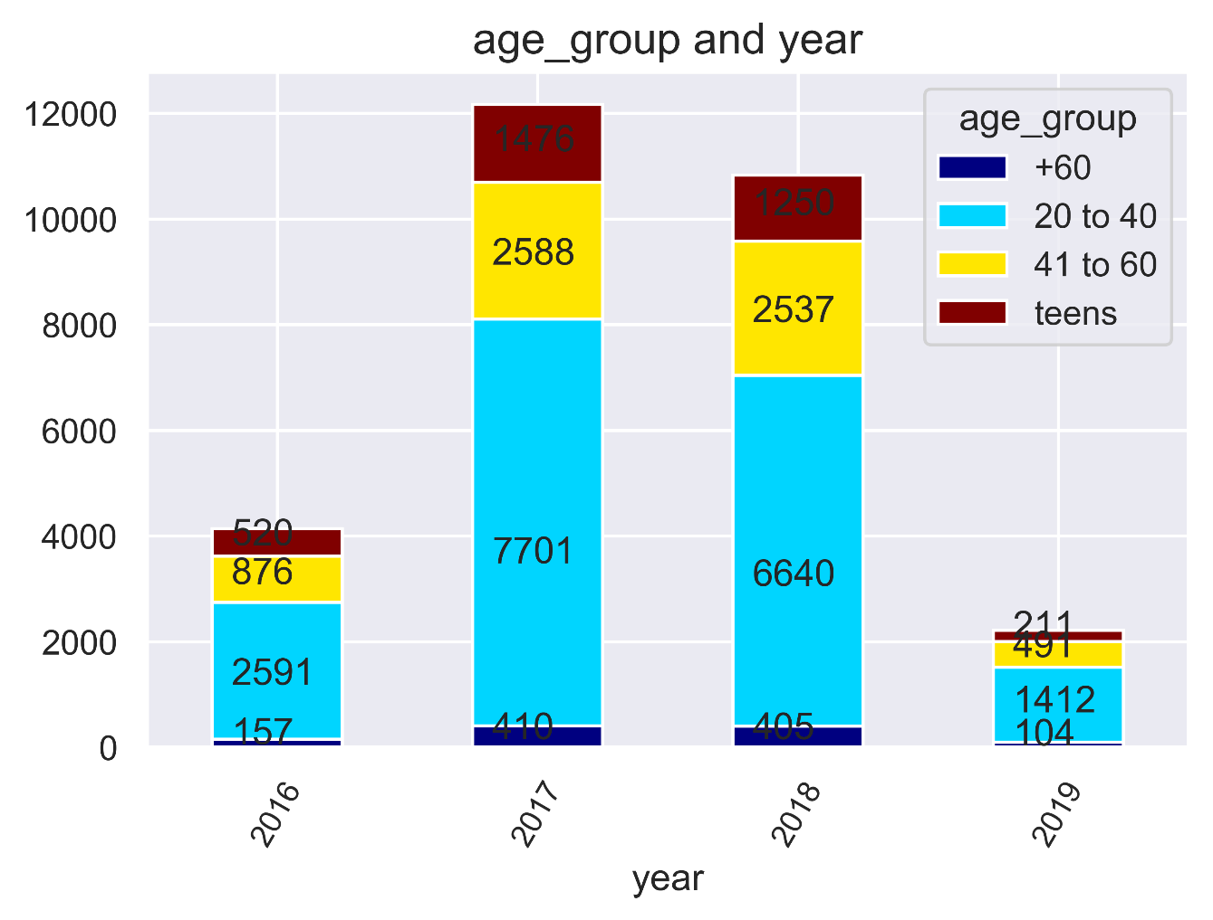
AGE
The challenge: correct the format!!

Slide 13
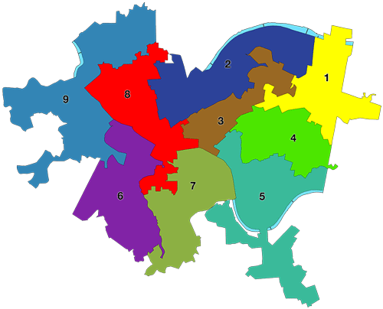
COUNCIL_DISTRICT, PUBLIC_WORKS_DIVISION
Q13: busiest council_dictrict?
Total rows:29369
Missing data in two columns
COUNCIL_DISTRICT 26062
PUBLIC_WORKS_DIVISION 26060
COUNCIL_DISTRICT
counts %
6.0 4988 19.138976
1.0 4563 17.508250
9.0 4476 17.174430
3.0 3977 15.259765
4.0 2290 8.786739
2.0 2129 8.168982
7.0 1556 5.970378
5.0 1340 5.141585
8.0 743 2.850894
PUBLIC_WORKS_DIVISION
counts %
3.0 7267 27.885649
2.0 6053 23.227168
1.0 5688 21.826554
5.0 4902 18.810437
6.0 2150 8.250192

Slide 14
INCIDENTNEIGHBORHOOD
Q14: safest and worst neighborhood?
Q15: incident location and arrestment?
Sol: take care of missing data
create two lists of incident and arrest
compare two lists and count same zipecodes
INCIDENTLOCATION and ARRESTLOCATION
68% same places
32% different places
INCIDENTNEIGHBORHOOD
Head of the list
Central Business District 1682
South Side Flats 1675
Carrick 1036
East Allegheny 1017
Homewood South 910
Tail of the list
New Homestead 18
Mt. Oliver Boro 10
Ridgemont 10
Troy Hill-Herrs Island 6
Mt. Oliver Neighborhood 2
Advanced Q: correlation of type of the crime and location of arrestment

Slide 15
OFFENSES
Q16: Find the most common offense in dataset
The challenge: offense codes have several formats which require a real cleaning
Top 5 records:
'2701': 3956, Simple Assault
'13(a)(16) ': 2085, Possession of Controlled Substance
'9501': 1653, Bench Warrant
'903 ': 1619, Criminal Conspiracy
'2702': 1481, Aggravated Assault

